Slide 1

Broke or Nope?
A Bankruptcy Case Study
By: Brandon Thomas & Keegan Henderson

Slide 2

Data Overview
What is the data?
Bankruptcy Data
Features:
65 Columns of Data
43,405 Total Rows of Data
Who is represented?
Polish Companies and Their Financial Statements
Variables
Economic Measures of Corporate Success
UCI Machine Learning Reposity Link

Slide 3
Cleaning & Organization of Data
Converting from .arff file
Replacing NA's
Complications: Bankrupt Column

Slide 4
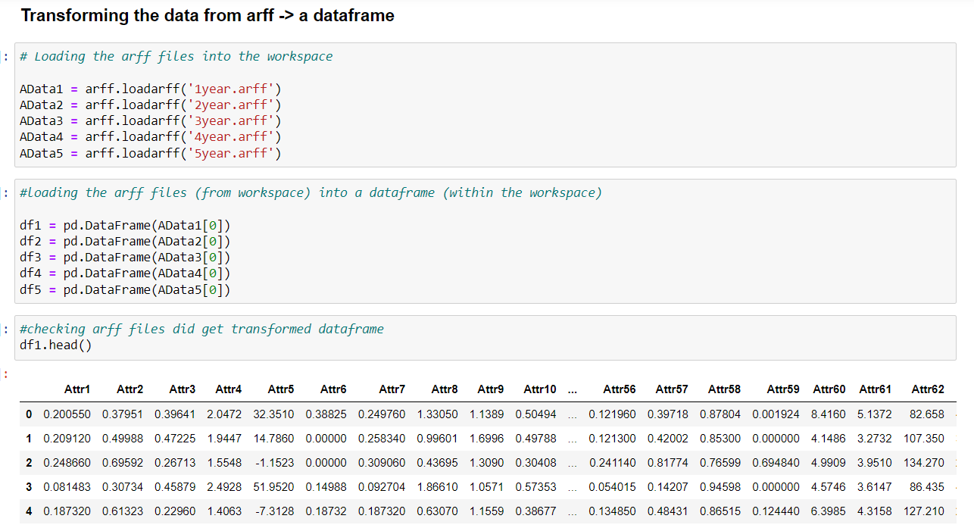
Converting ARFF File

Slide 5
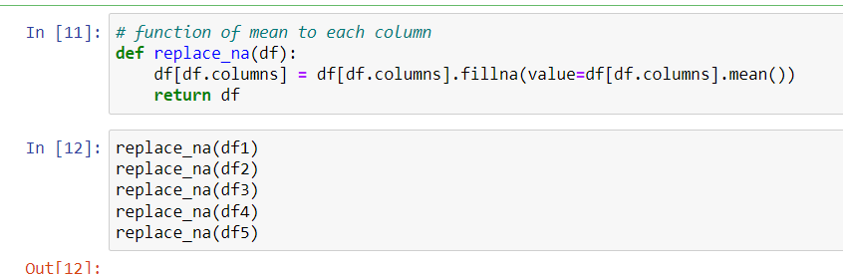
Replacing NA's
Total NA Rows: 5835

Slide 6
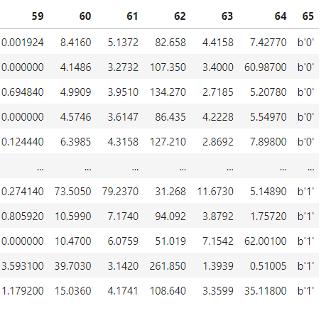
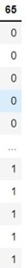











Complication: Bankrupt Column
Realizations
Type: Byte
Non-Bankrupt Columns: b'0'
Bankrupt Columns: b'1'

Slide 7
Visualization
Combining Data Frames
Correctly Naming Columns
Complications:
Determining cut-off for significance
Conceptually what to look for

Slide 8
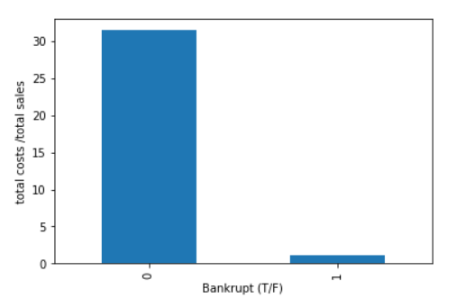
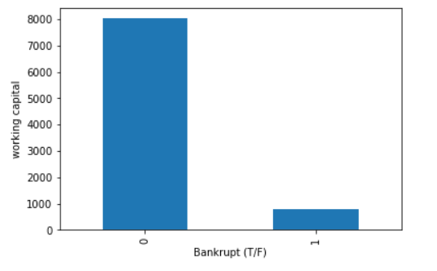
Large Positive Graphs

Slide 9
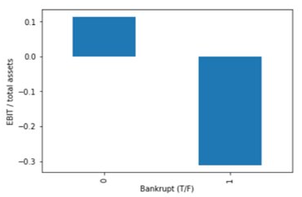
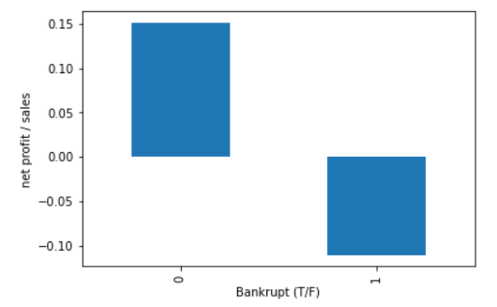
Positive and Negative Graphs

Slide 10
Regression & Machine Learning
Logistic Regression
Single & Multivariable
Decision Tree
Precision (true positives / true positives + false positives)
Recall (true positives / true positives + false negatives)
Better to overpredict (higher recall) than underpredict in terms of bankruptcy --> company can take measures to improve sooner
Random Forest
Problems
Syntax

Slide 11
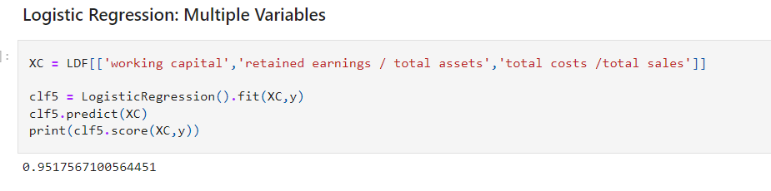
Logistic Regression: Multiple Variables

Slide 12
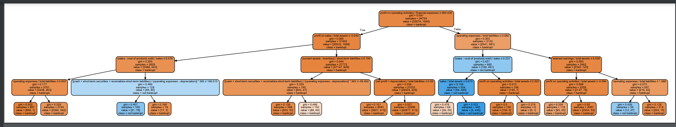
Bankruptcy Decision Tree
First Split - profit on operating activities / financial expenses

Slide 13
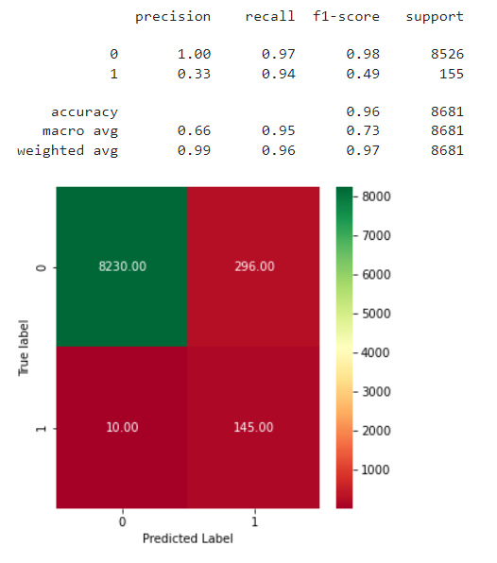
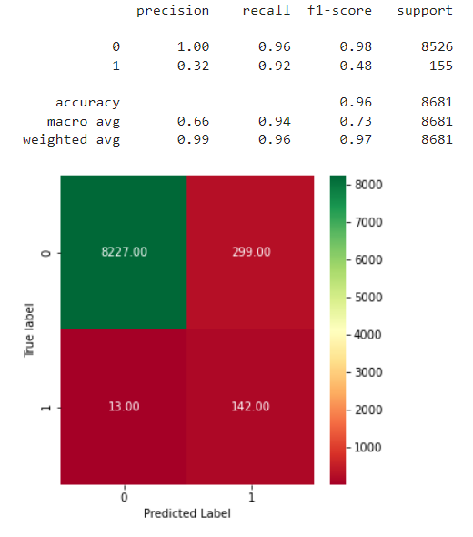
Result Comparison of Best Models
Decision Tree - (Sample Split – 3, Test Size - 0.2, Depth – 4)
Random Forest - (Test Size – 0.15, Number of Estimators – 18, Type – Entropy)

Slide 14
Questions & More Information
GitHub Link:
DS160_Final_Project_BWT_KSH
Repository Link:
UCI Machine Learning Repository: Polish Companies Bankruptcy Data

